Slide 1
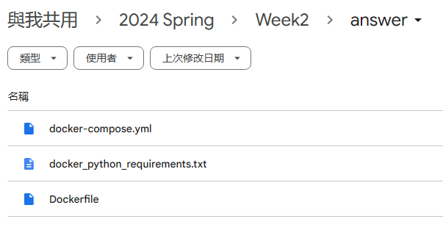
Week 3 Learn Tools – Homework review
Download files from here:
http://gg.gg/mvclab-tutorial-week-2
Author ：Sheng-Hao Liao (frakw)
Date ：2024-05-08
Email ：frakwu@gmail.com

Slide 2
Outline
01
Homework 1
02
Homework 2
03
Homework 3

Slide 3
01 Homework 1

Slide 4
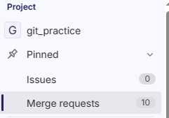
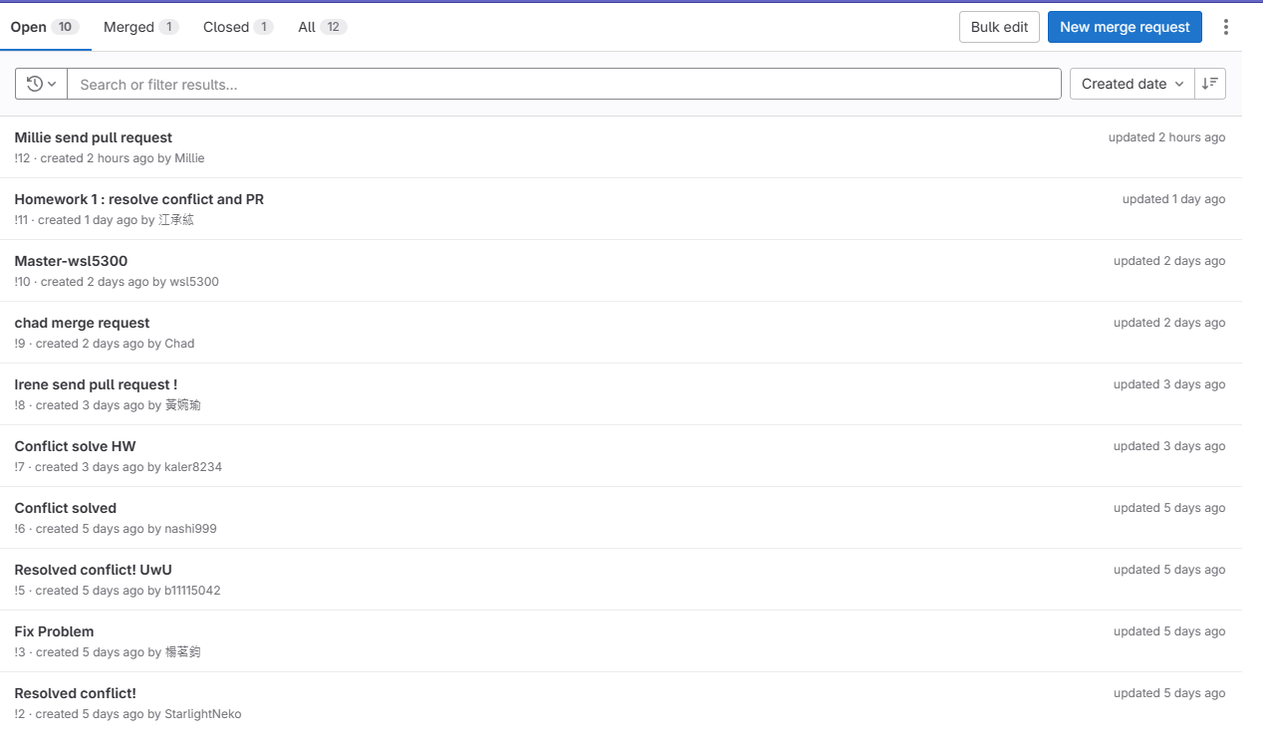
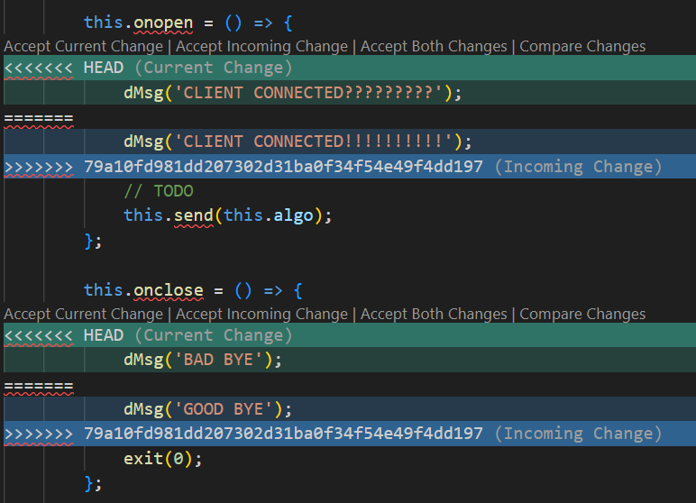
Homework 1 – Git resolve conflict & PR
git pull
Use vscode to resolve conflict
Fork my gitlab repo
Commit & push to your own repo

Slide 5
02 Homework 2

Slide 6
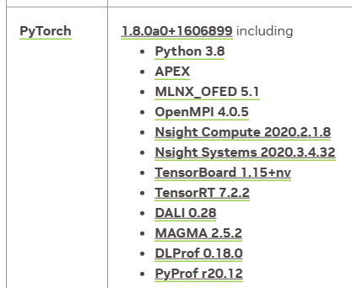
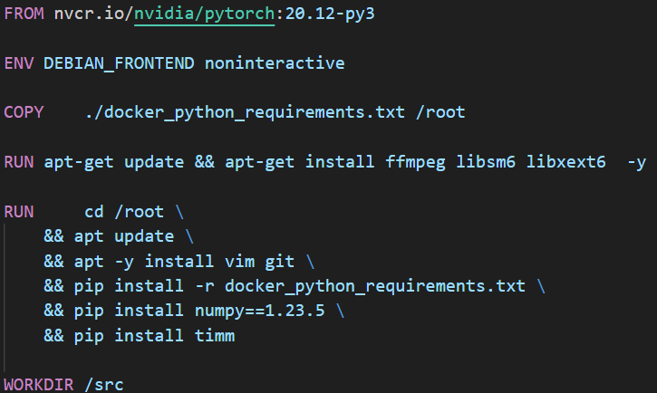
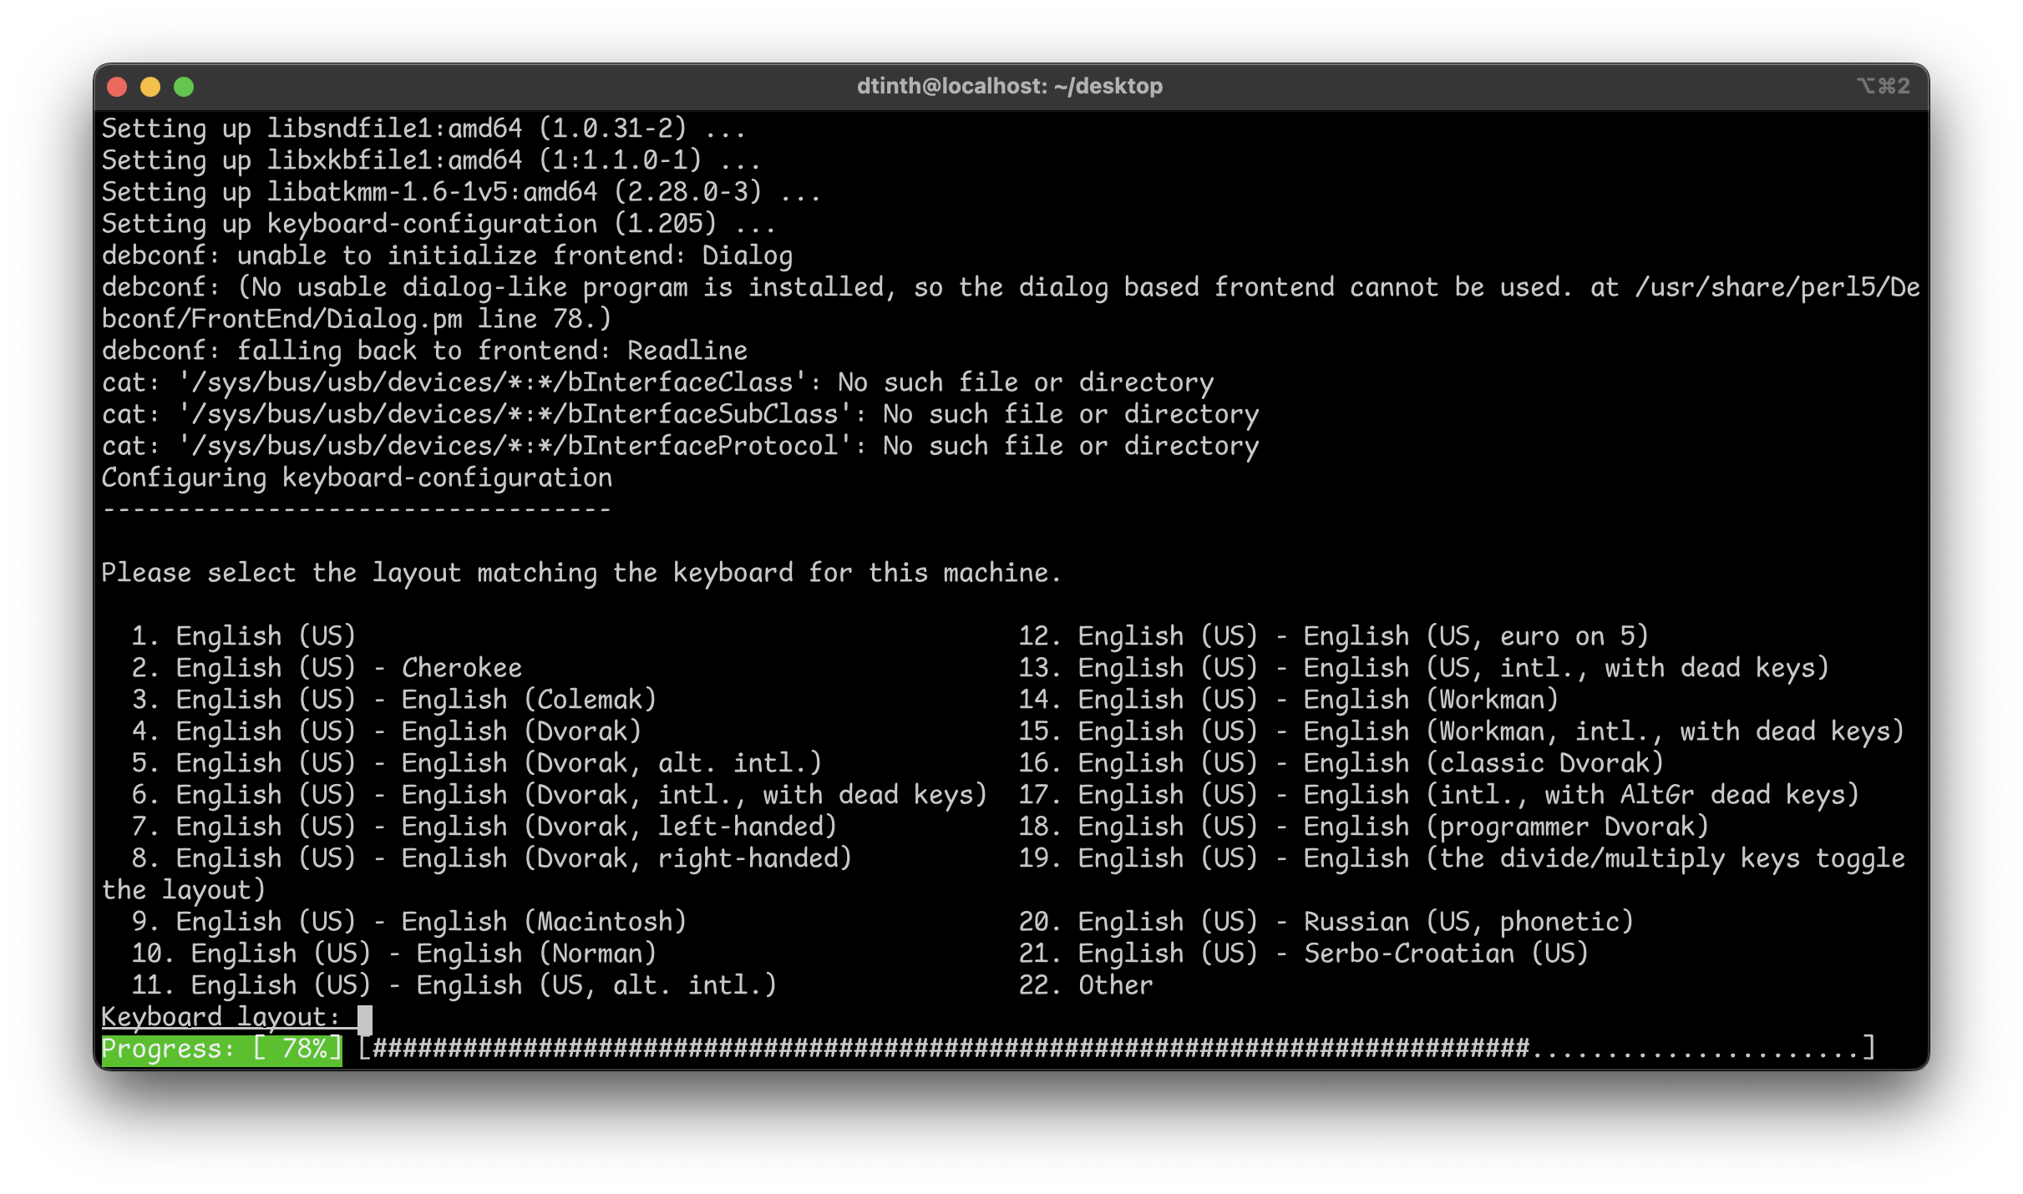
Homework 2 - Dockerfile
nvcr.io/nvidia/pytorch:20.12-py3
https://docs.nvidia.com/deeplearning/frameworks/support-matrix/index.html
Python 3.8 + PyTorch 1.8.0 + CUDA 11.1 base on ubuntu 20.04
DEBIAN_FRONTEND noninteractive
Avoid asking question
apt -y install : auto check yes in cli

Slide 7
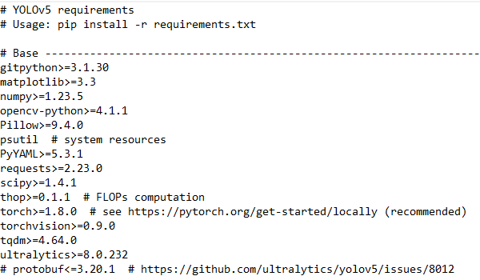
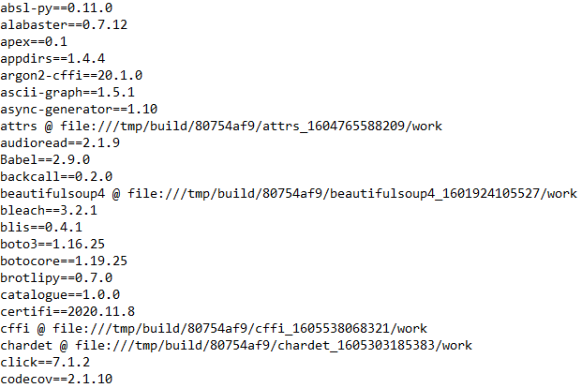
Use fixed version python packge
docker_python_requirements.txt
After successfully install the correct version in docker container
pip3 freeze > docker_python_requirements.txt

Slide 8
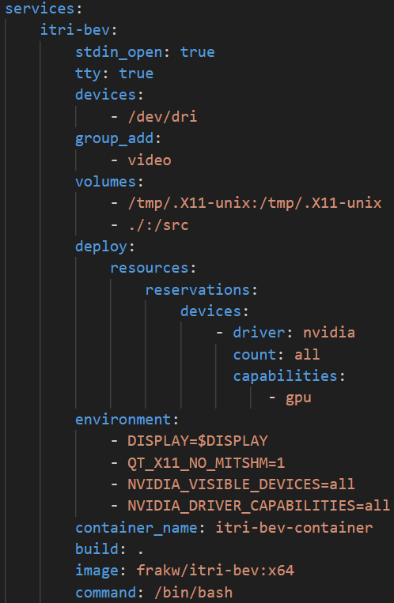
Homework 2 – docker-compose.yaml
stdin_open + tty : equal to –it, make shell available
devices + group_add
DRI（Direct Render Infrastructure）
GPU hardware acceleration
For unprivileged container
Volumes
Enable x11 support
Mount code folder into /src
Deploy
--gpus=all : assign all gpu to container
Environment
DISPLAY=$DISPLAY, QT_X11_NO_MITSHM=1 : GUI support
NVIDIA_VISIBLE_DEVICES : gpu filter
NVIDIA_DRIVER_CAPABILITIES : gpu function filter

Slide 9
Specific GPU to use on workstation
CUDA_VISIBLE_DEVICES=3 python train.py
Use 4th GPU to train
CUDA_VISIBLE_DEVICES=0,2
Comma to separate multiple index
MVCLab 實驗室工作站 - HackMD

Slide 10
03 Homework 3

Slide 11
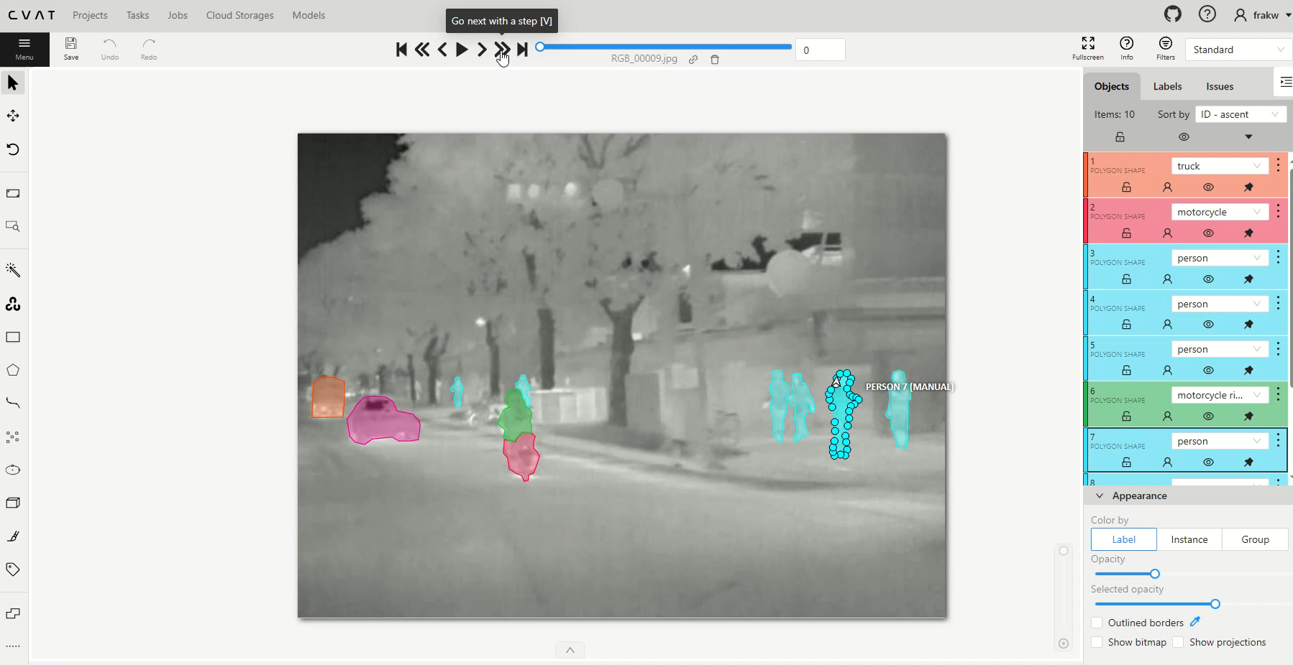
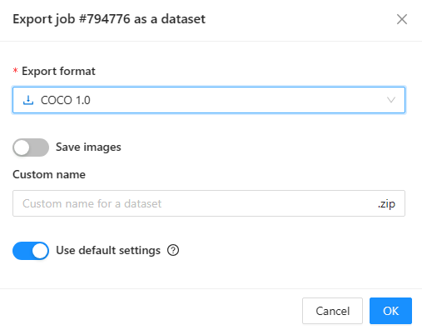
CVAT label car_segmentation

Slide 12
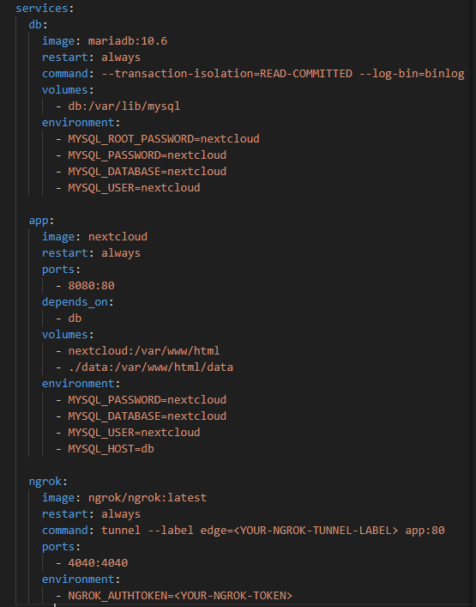
Optional homework : ngrok + nextcloud
https://dev.to/natjuung/a-step-by-step-guide-to-building-your-private-cloud-with-nextcloud-2023-em5
Demo : https://tapir-noted-lacewing.ngrok-free.app/s/zdF9z6oQJ6Eys5d

Slide 13
Thank you for your attention!

Slide 14
Reference
docker/Tutorials/Hardware Acceleration - ROS Wiki
Hardware acceleration · mviereck/x11docker Wiki (github.com)
Run A GUI APPs inside a Docker Container | by Dipaditya Das | Geek Culture | Medium
在容器运行时生态系统中启用 GPU - NVIDIA 技术博客
MVCLab 實驗室工作站 – HackMD
Frameworks Support Matrix - NVIDIA Docs
PyTorch | NVIDIA NGC
apt - DEBIAN_FRONTEND environment variable - Ask Ubuntu
A Step-by-Step Guide to Building Your Private Cloud with Nextcloud (2023) - DEV Community

